Slide 1
Dentition of horse exam
By youssef samir

Slide 2
What is the age of the animal? And why?

Slide 3
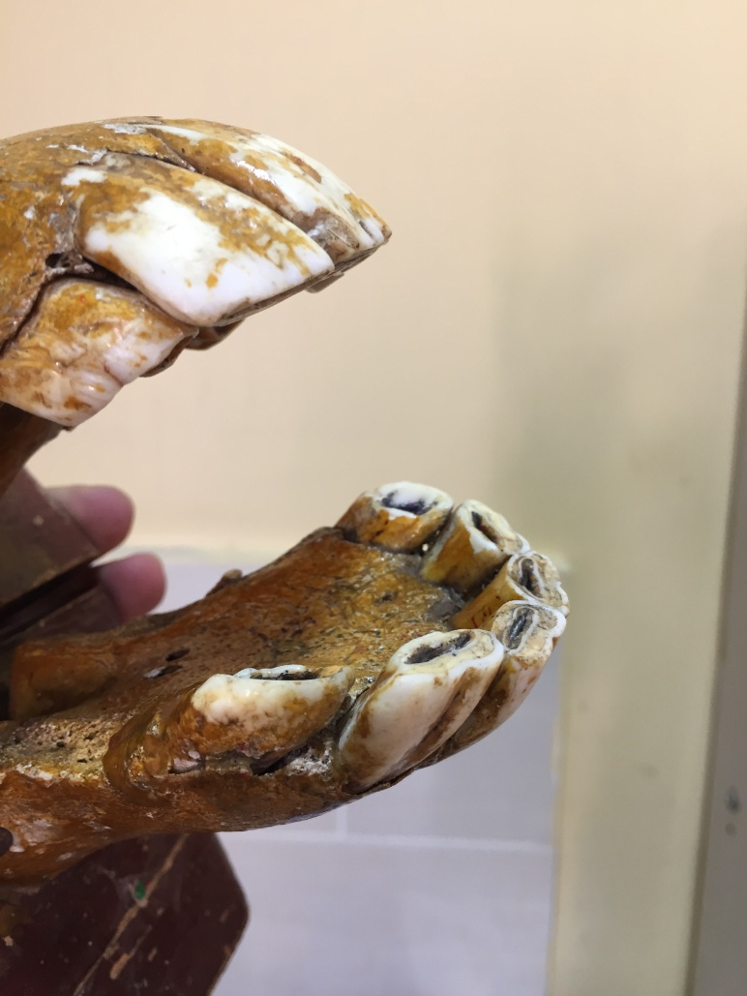
Sample 1

Slide 4
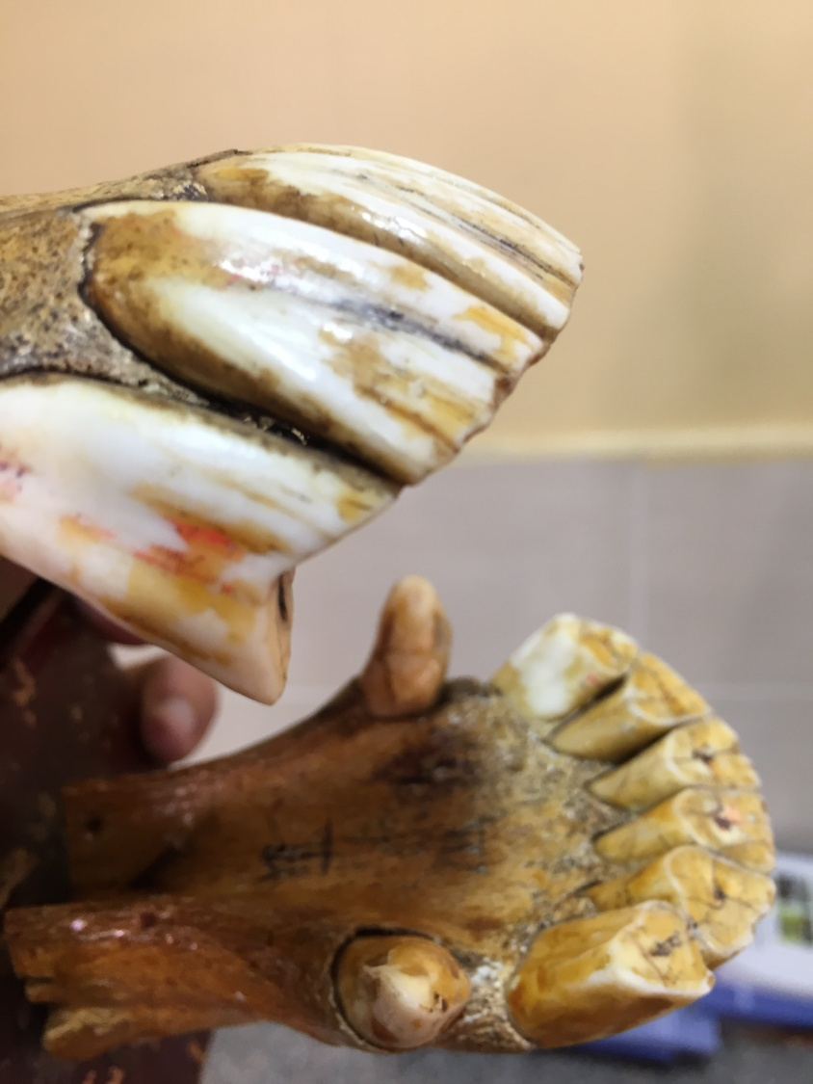
Sample 2

Slide 5
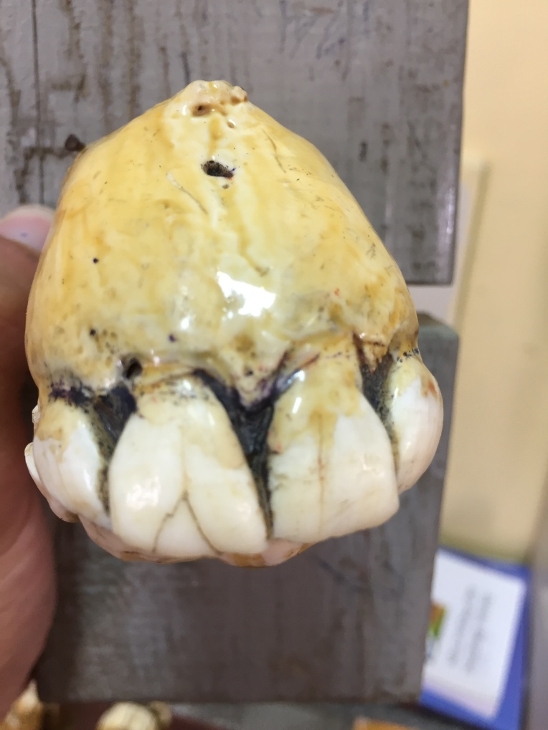
Sample 3

Slide 6
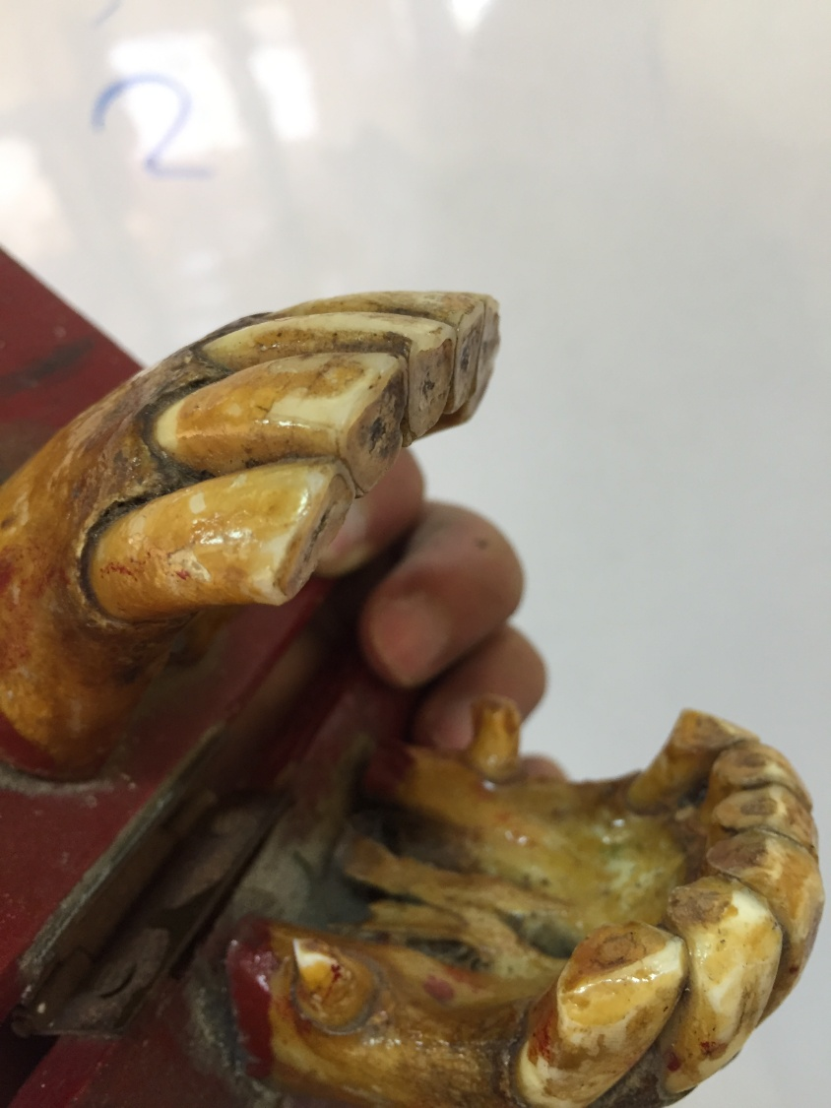
Samlpe 4

Slide 7
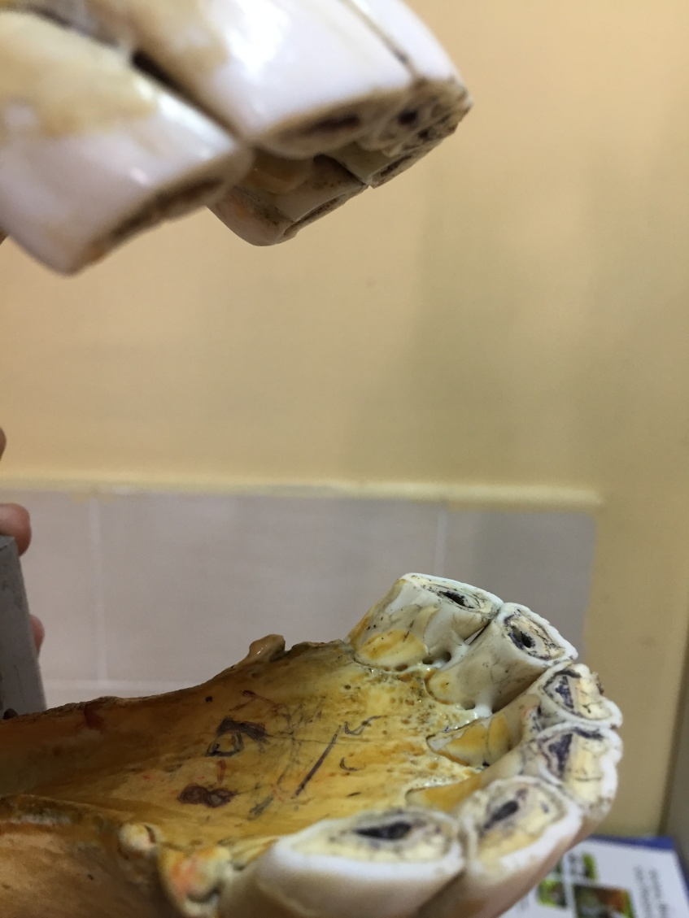
Sample 5

Slide 8
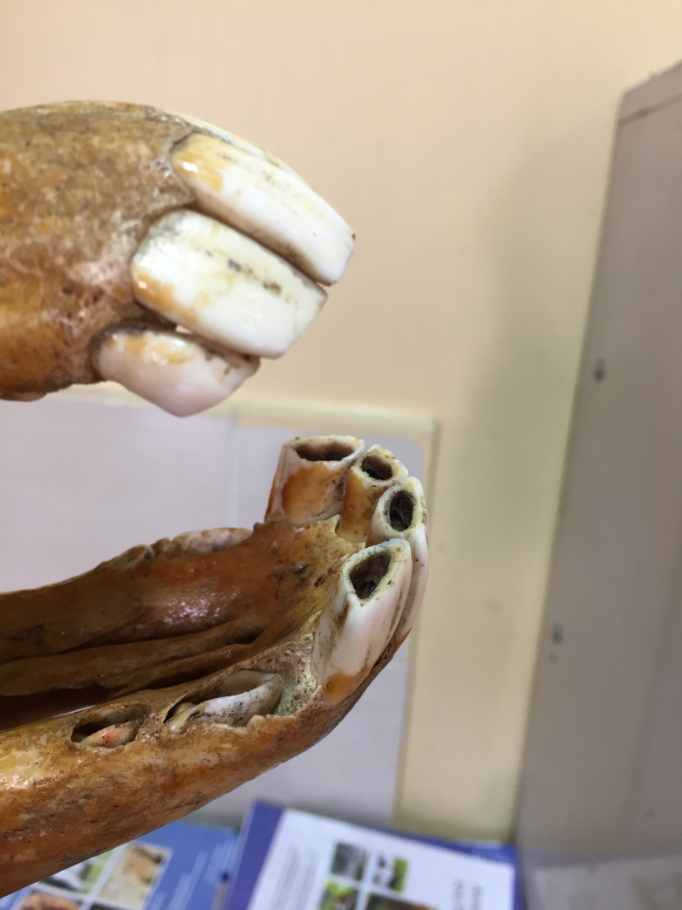
Sample 6

Slide 9
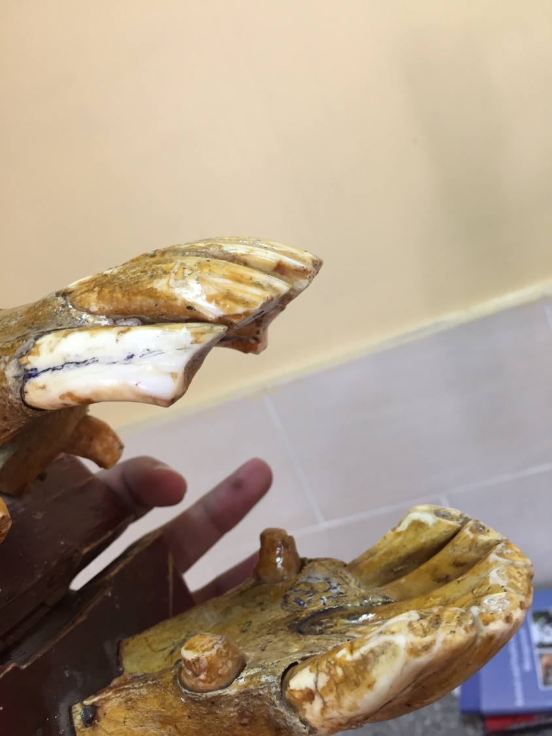
Sample 7

Slide 10
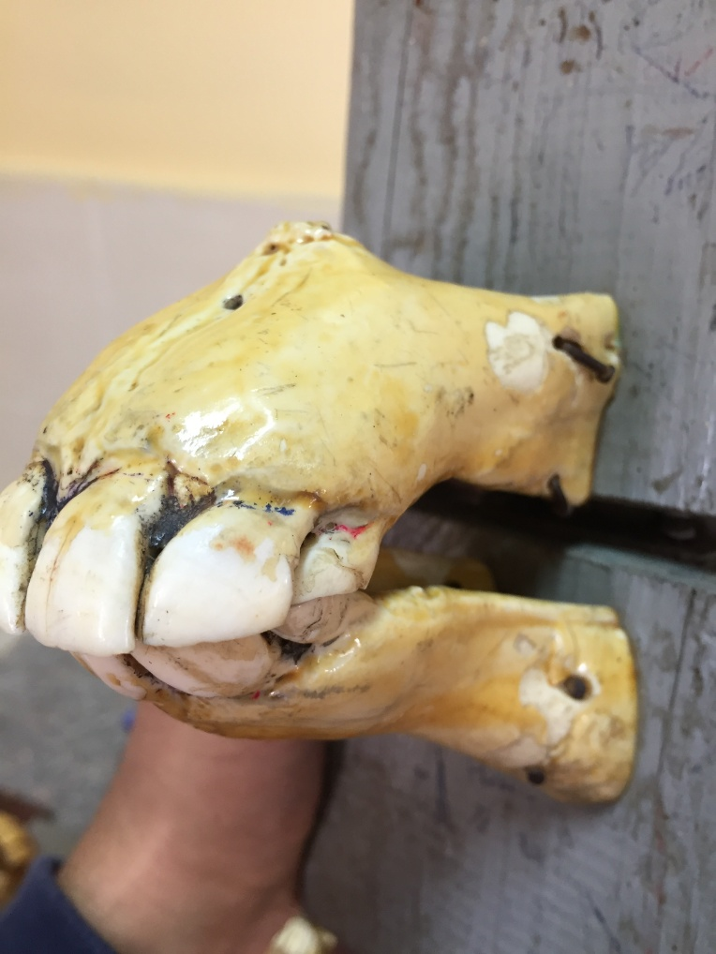
Sample 8

Slide 11
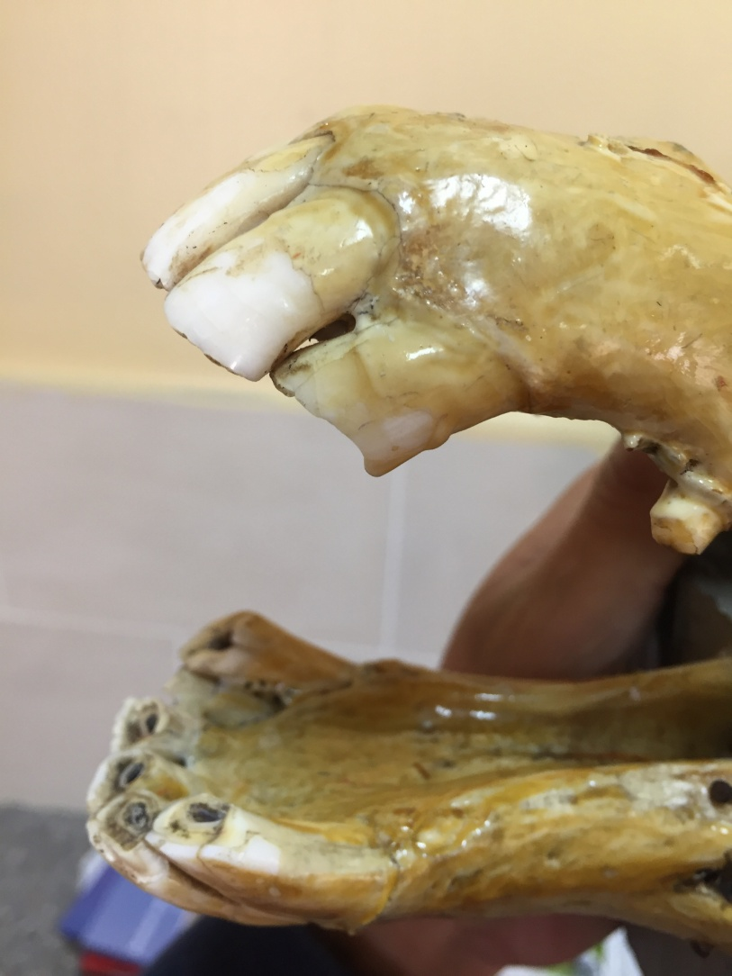
Sample 9

Slide 12
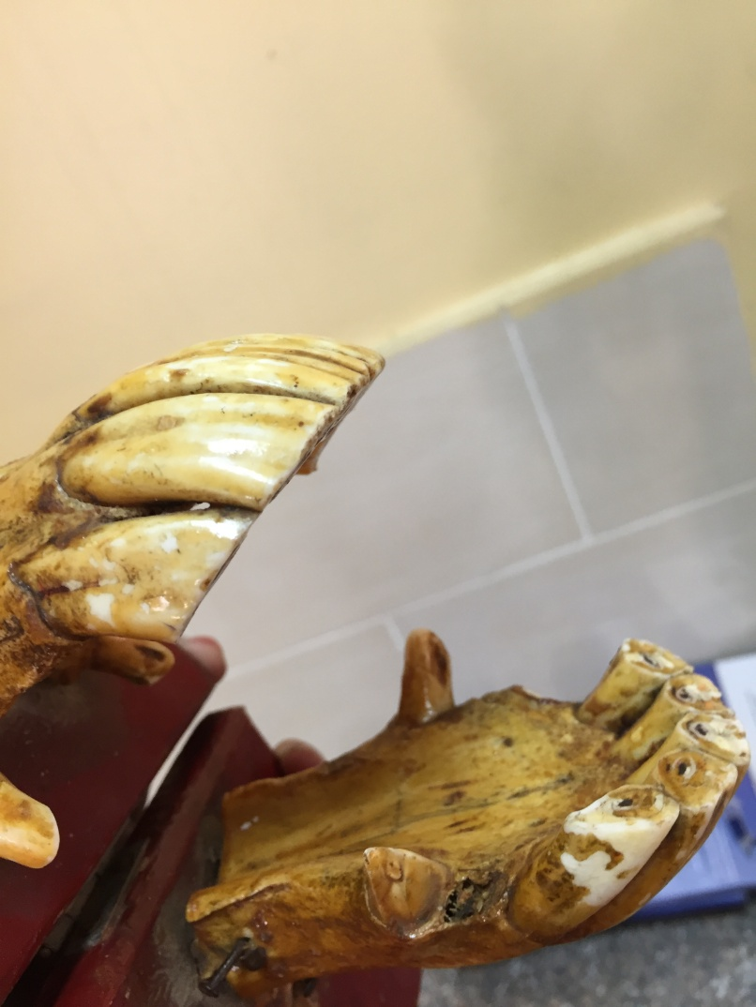
Sample 10

Slide 13
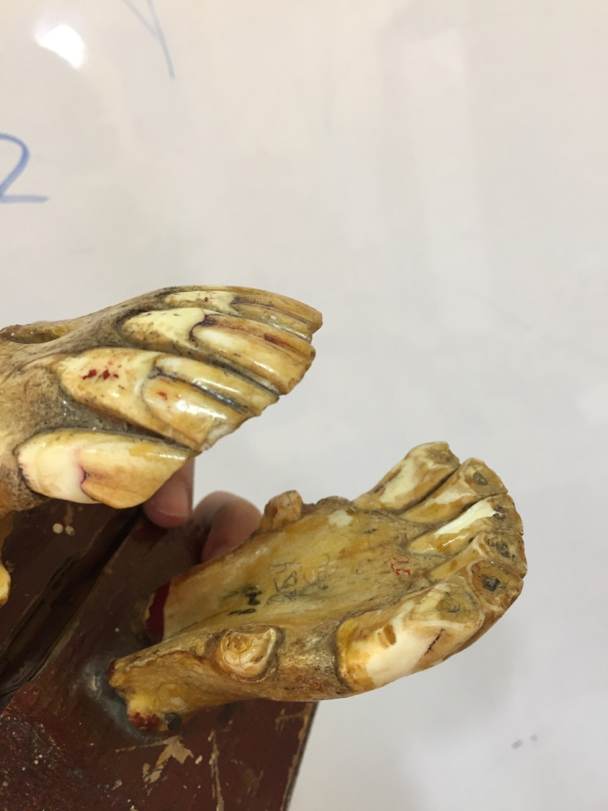
Sample 11

Slide 14
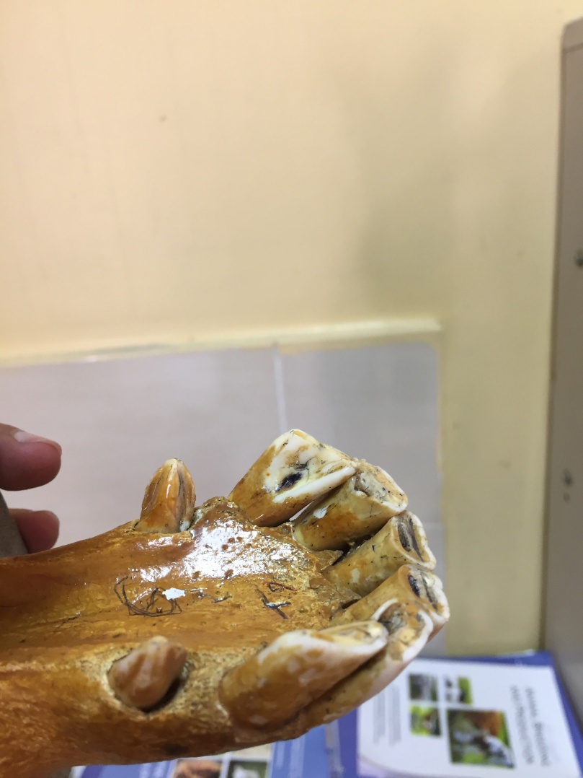
Sample 12

Slide 15
Answers:

Slide 16
Sample 1:
Age: 5 years
Reason: Full permenant mouth, infundibulum is clear, no hock,galvayne groove,enamel rings or dental star present
Sample 2:
Age: 17 years
Reason: hock (notch) in the upper corner,galvayne groove almost reached the whole length, in addition to dental star in incisors,indicates it’s 17 years old
Sample 3:
Age: 1 year
Reason: full temporary mouth
Sample 4:
Age: 30 years
Reason: galvayne groove completely disappeared and dental stars are present in all incisors, narrower mouth angle

Slide 17
Sample 5:
Age: 8 years (8-9)
Reason: infundibulum disappearance And appearance of enamel ring in the central pair of incisors, which indicates That it’s 8-9 years old
Sample 6:
Age: 4 years
Reason: the central and lateral incisors errupted, while the corners didn’t
Sample 7:
Age: 20 years
Reason: galvayne’s groove covers the whole length of the upper corner incisor
Sample 8:
Age: 1 year
Reason: full temporary mouth

Slide 18
Sample 9:
Age: 7 years
Reason: full permenant mouth, hock in upper cr and infundibulums are clear at the same time
Sample 10:
Age: 10/11 year
Reason: galvaynes groove reached the upper part of upper cr, Enamel rings at all incisors
Sample 11:
Age: 25 year
Reason: galvayne’s groove disappeared from above to middle of upper cr
Sample 12:
Age: 6 years
Reason: shelly appearance of incisors

